Slide 1
NETWORK ANALYSIS AND EVALUATION OF PROJECT

Slide 2
Introduction
Management of any project involves planning, coordination and control of a number of interrelated activities with limited resources.
Furthermore, it becomes necessary to incorporate any change from the initial plan as they occur, and immediately know the effects of the change

Slide 3
Network Analysis
Network analysis is a common name for a number of associated projects which need planning and control procedures which based on the concept of network.
It provides a framework which :
  defines the job to be done,
  integrates them in a logical time sequence and finally,
  affords a system of dynamic control over the progress of the plan

Slide 4
Phases of project management
Network analysis helps in all the phases of project management. There phases are mainly
Planning
Scheduling
Controling

Slide 5
Planning
Identify the distinct activities,
Determine their durations and inter dependencies
Construct a network diagram,
Determine minimum overall project duration (using the network diagram),
Identify the tasks critical (i.E. Essential) to this minimum duration.

Slide 6
Scheduling
Construct schedule (‘time chart’),
Schedule contains start and finish times for each activity, and
Evaluate cost-time trade-offs (evaluate effects of putting extra money, people or machines in a particular task in order to shorten project duration).

Slide 7
Controlling
Monitor/control project by use of network diagram,
Follow progress of the various activities
Make adjustment where appropriate (as network analysis make the planning susceptible to change in original plan)

Slide 8
Networking techniques
There are mainly two types of networking techniques which are used in project evaluation
CPM – Critical Path Method
PERT – Project Evaluation and Review Technique

Slide 9
CPM
CPM is akin to PERT as both techniques use similar network models and methods are have the same general purpose.
But CPM is primarily concerned with the trade-off between cost and time.
It has been applied mostly to projects that employ fairly stable technology and are relatively risk free.
Hence its orientation is ‘deterministic’

Slide 10
PERT
PERT is eminently suitable for
  research and development and programmes, aerospace projects,
  other projects involving new technology.
In such projects the time required for completing various jobs or activities can be highly variable.
Hence the orientation of PERT is probabilistic

Slide 11
Why PERT/CPM
The PERT/CPM is capable of giving answers to the following questions to the project manager :
When will the project be finished ?
When is each individual part of the scheduled to start and finish ?
Of the numerous jobs in the project, which one must be timed to avoid being late ?
Is it possible to shift resources to critical jobs of the project from other non-critical jobs of the project without affecting the overall completion time of the project ?
Among all the jobs in the project, where should management concentrate its efforts at one time ?

Slide 12
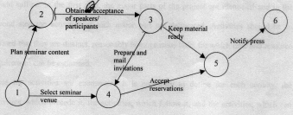
Project network

Slide 13

Basic Elements of Network
In order to represent a project network, two basic elements are used which are node and activity.
A circle called “node”, represents an event.
An event describes a checkpoint.
It does not symbolize the performance of work, bit it represents the point in time in which the event is accomplished.

Slide 14
Cont’d
An arrow, called “arc”, represents an activity-a recognizable part of the project.
It involve mental or physical work and require time and resources for its completion.
The network will try to reflect all the relationships between the activities.
  Arrow direction indicates general progression in time – tail events represent start while head events represent end of activities

Slide 15


Rules for constructing a project network
The simple rules govern the construction of a project network :
Each activity must be represented by only one directed arc or arrow.
No two activities can begin and end on the same two nodes circle
There should be no loops in the network.
  Events are identified by numbers while activities are represented by their starting and ending events

Slide 16

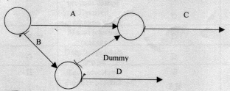
Dummy activity
Dummy activities are Tasks that must be completed in sequence but that don’t require resources or completion time are considered to have event dependency.
These are represented by dotted lines with arrows and are called dummy activities.
To explain it, we will consider the following
ACTIVITY IMMEDIATE PREDECESSOR
A .........................
B .........................
C A, B
D B

Slide 17
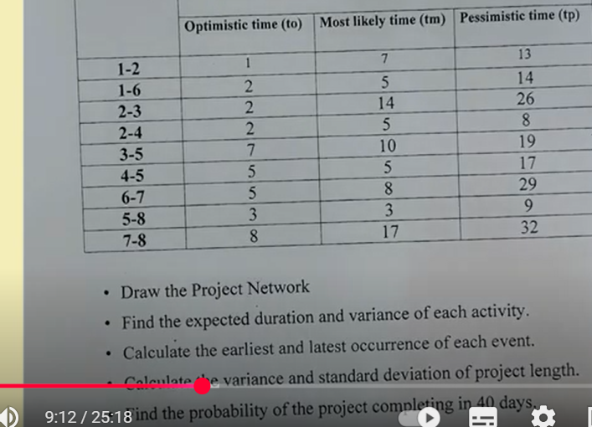
Numerical

Slide 18
Activity | Imm. Pred. | Activity | Imm. Pred.
A | - | G | C, F
B | - | H | B
C | - | I | E, H
D | A, B | J | E, H
E | B | K | C, D, F, J
F | B | L | K
4
E
2
H
5
I
B
F
C
G
J
1
6
9
A
L
D
K
8
3
7

Slide 19
Critical Path
Critical path refers to the longest path of a given project network
Duration of a project is given by the length of the critical path
Activities on a critical path are called critical activities while remaining activities are non-critical
A project can have more than one critical path as well
Critical activities are so called because their timely completion is critical to the completion of the project in time
Critical activities can not be delayed while non-critical activities have some cushion available

Slide 20
Critical Path:
Example:
Information on the activities required for a project is as follows:
Draw the network and calculate the earliest start(ES), earliest finish(EF), latest start(LS), and latest finish(LF) times of each of the activities.
Name | A | B | C | D | E | F | G | H | I | J | K
Activities Node | 1-2 | 1-3 | 1-4 | 2-5 | 3-5 | 3-6 | 3-7 | 4-6 | 5-7 | 6-8 | 7-8
Duration (Days) | 2 | 7 | 8 | 3 | 6 | 10 | 4 | 6 | 2 | 5 | 6

Slide 21
Critical path evaluation
i - j | t | ES | EF | LS | LF | slack
1-2 | 2 | 0 | 2 | 9 | 11 | 7
1-3 | 7 | 0 | 7 | 0 | 7 | 0
1-4 | 8 | 0 | 8 | 3 | 11 | 3
2-5 | 3 | 2 | 5 | 11 | 14 | 9
3-5 | 6 | 7 | 13 | 8 | 14 | 1
3-6 | 10 | 7 | 17 | 7 | 17 | 0
3-7 | 4 | 7 | 11 | 12 | 16 | 5
4-6 | 6 | 8 | 14 | 11 | 17 | 3
5-7 | 2 | 13 | 1 | 14 | 16 | 15
6-8 | 5 | 17 | 22 | 17 | 22 | 0
7-8 | 6 | 15 | 21 | 16 | 22 | 1

Slide 22
Critical Path (…continued)
Critical Path: 1-3-6-8
Critical Activities: B F J
Project Duration: 22 days
Non-critical Activities: A C E G H I K
2
D 3
5
A 2
I 2
E 6
1
B 7
3
G 4
7
K 6
8
C 8
F 10
J 5
4
H 6
6

Slide 23
Floats
Total float is the amount of time by which an activity may be delayed without delaying the project completion
Caution: interpret total floats of activities carefully - all can not be used independently
Free float is that part of total float which can be used without affecting floats of the succeeding activities
Independent float is the amount of time which can be used without affecting the head and the tail events
Total Float ≥ Free Float ≥ Independent Float

Slide 24
Calculation of Floats
Total float
= Latest start time of the activity – Earliest start time of the activity
Free float
= Earliest start time of the next activity – Earliest finish time of the activity
Interfering float
= Total float – Free float
Independent float
= Earliest start time of the next activity – Latest finish time of the preceding activity – Duration of the activity
= Free float – Tail event slack, or zero, whichever is higher

Slide 25
Floats Calculation
i - j | t | ES | EF | LS | LF | TF | FF | lnF
1-2 | 2 | 0 | 2 | 9 | 11 | 9 | 0 | 0
1-3 | 7 | 0 | 7 | 0 | 7 | 0 | 0 | 0
1-4 | 8 | 0 | 8 | 3 | 11 | 3 | 0 | 0
2-5 | 3 | 2 | 5 | 11 | 14 | 9 | 8 | 0
3-5 | 6 | 7 | 13 | 8 | 14 | 1 | 0 | 0
3-6 | 10 | 7 | 17 | 7 | 17 | 0 | 0 | 0
3-7 | 4 | 7 | 11 | 12 | 16 | 5 | 4 | 4
4-6 | 6 | 8 | 14 | 11 | 17 | 3 | 3 | 0
5-7 | 2 | 13 | 15 | 14 | 16 | 1 | 0 | 0
6-8 | 5 | 17 | 22 | 17 | 22 | 0 | 0 | 0
7-8 | 6 | 15 | 21 | 16 | 22 | 1 | 1 | 0

Slide 26
Time estimation in PERT
For each activity, the model usually includes three times estimates
  Optimistic time (a) - generally the shortest time in which the activity can be completed under ideal, favorable conditions
  Most likely time (m) - the completion time under the normal conditions, having the highest probability.
  Pessimistic time (b) - the longest time under worst, externally unfavorable conditions, which an activity might require

Slide 27
Expected time
The expected time for each activity can be approximated using the following weighted average
Expected time = (Optimistic + 4 x Most likely + Pessimistic) / 6
te=(a+4m+b)/6
Variance is [(b – a )/6]²

Slide 28
The owner of a chain of fast-food restaurants is considering a new computer system for accounting and inventory control. A computer company sent the following information about the system installation:
Activity |  | Immediate Predecessor | Most Optimistic | Most likely | Most Pessimistic
A |  | - | 4 | 6 | 8
B |  | A | 5 | 7 | 15
C |  | A | 4 | 8 | 12
D |  | B | 15 | 20 | 25
E |  | B | 10 | 18 | 26
F |  | C | 8 | 9 | 16
G |  | E | 4 | 8 | 12
H |  | D,F | 1 | 2 | 3
I |  | G,H | 6 | 7 | 8

Slide 29

PERT Calculations
Example
Activity | a | m | b | t_{e} | σ²
A | 4 | 6 | 8 | 6 | 4/9*
B | 5 | 7 | 15 | 8 | 25/9*
C | 4 | 8 | 12 | 8 | 16/9
D | 15 | 20 | 25 | 20 | 25/9
E | 10 | 18 | 26 | 18 | 64/9*
F | 8 | 9 | 16 | 10 | 16/9
G | 4 | 8 | 12 | 8 | 16/9*
H | 1 | 2 | 3 | 2 | 1/9
I | 6 | 7 | 8 | 7 | 1/9*
  Critical activities: A B E G I
  Project duration = 6+8+18+8+7 = 47 days
  Project variance = 4/9 + 25/9 + 64/9 + 16/9 + 1/9 = 110/9
  Project standard deviation = √(110/9) = 3.496

Slide 30
PERT Calculations (…continued)
Project Network
E
B
D
G
A
H
I
C
F
  For Pr (completion in 55 days): Z = (X - µ)/σ
  Z = (55 – 47)/3.496 = 2.29. Now, Area to the left of Z = 2.29 is 0.5+0.4890 = 0.9890
  For Pr (completion with 0.90 chance):
  Z corresponding to area 0.40 (between µ and X) is 1.28. Thus, 1.28 = (X – 47)/3.496 and X = 51.47 or 52 app.
  The project should start 52 days before due date

Slide 31
Advantages of PERT/CPM
Especially useful when scheduling and controlling large projects
Straightforward concept and not mathematically complex
Graphical networks help to perceive relationships among project activities
Critical path and slack time analyses help pinpoint activities that need to be closely watched
Project documentation and graphics point out who is responsible for various activities
Applicable to a wide variety of projects
Useful in monitoring not only schedules but costs as well

Slide 32
Disadvantages of PERT/CPM
Project activities have to be clearly defined, independent, and stable in their relationships
Precedence relationships must be specified and networked together
Time estimates tend to be subjective and are subject to fudging by managers
There is an inherent danger of too much emphasis being placed on the longest or critical path

Slide 33
THANK YOU

